Slide 1
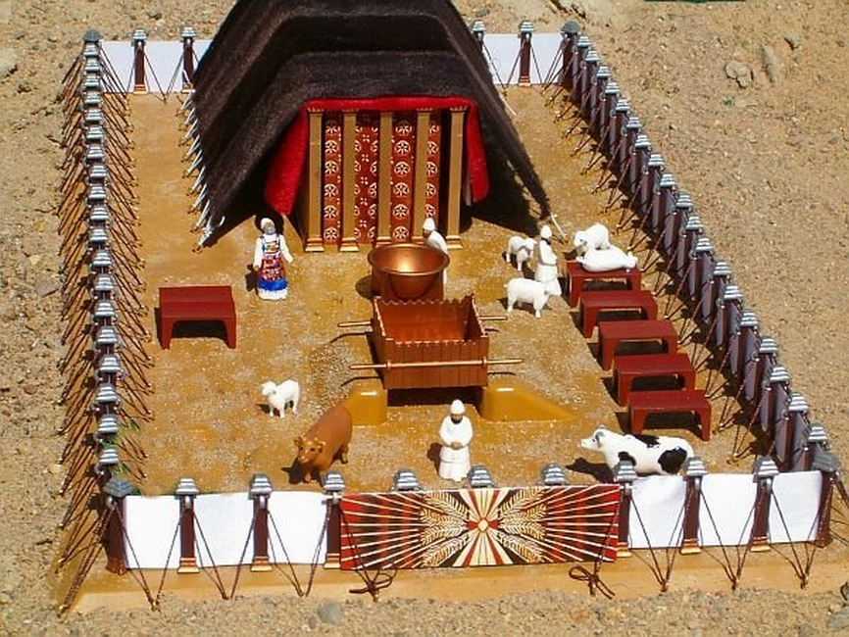
Tabernacle of Moses
1

Slide 2
Four things every believer needs in Christ
LORDSHIP
FELLOWSHIP
STEWARDSHIP
WORSHIP
2

Slide 3
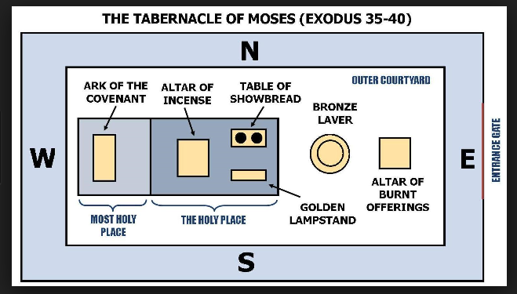
M S
Worship
Stewardship
Fellowship
Lordship
3

Slide 4
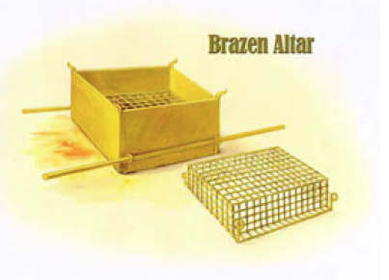
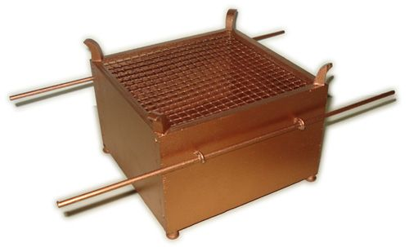
Outer Court
Jesus Christ - Death – The Cross – Sacrifice - Lordship
4

Slide 5
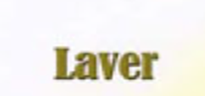
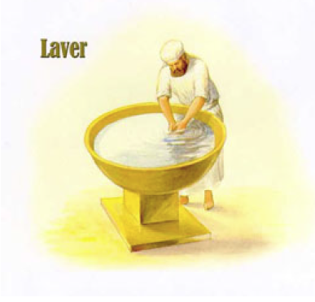
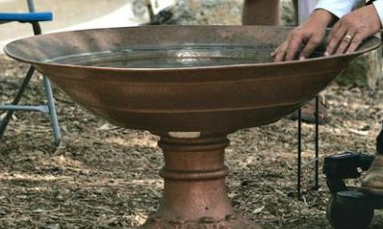
Outer Court
Jesus Christ – Burial – Baptism - Lordship
5

Slide 6
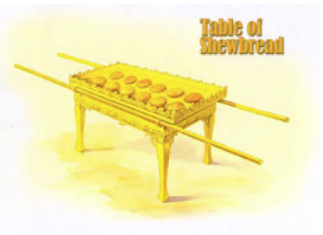
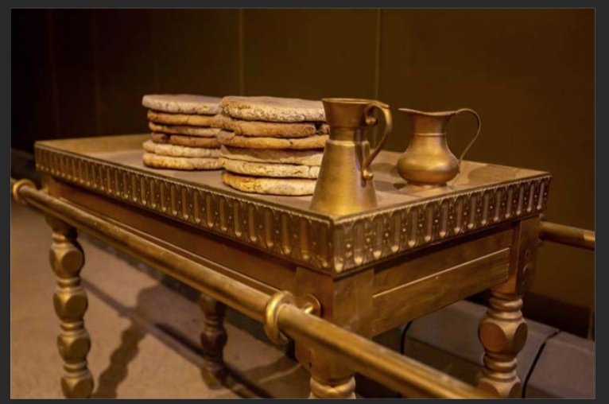
Holy Place
Jesus Christ – Bread of life –Fellowship - with God and Man
6

Slide 7
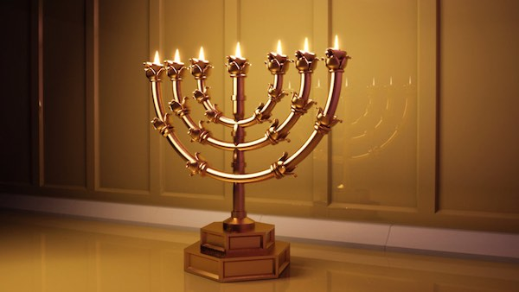
Holy Place
Jesus Christ – Light of the World – We are the light of the World -Stewardship
7

Slide 8
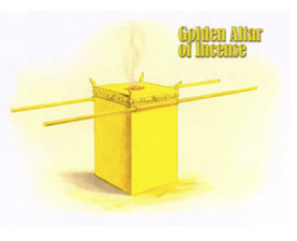
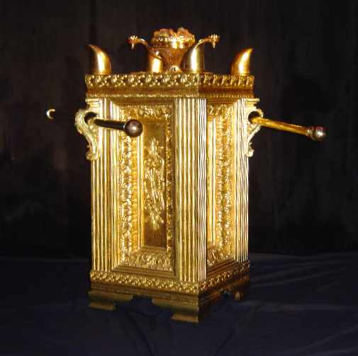
Holy Place
8
Jesus Christ – Worship – Intercession – Continuous Prayer

Slide 9
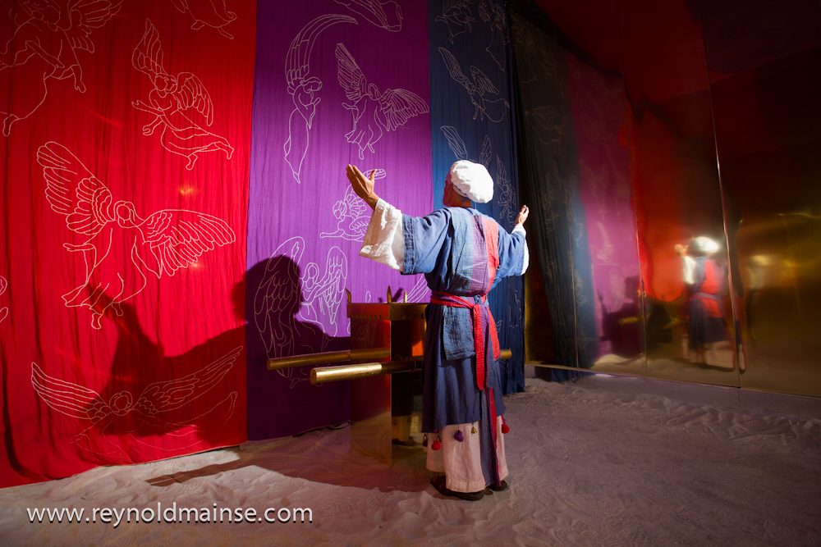
The Veil of the Tabernacle
9
Separates the Holy Place - and Holy of Holies – Worship

Slide 10
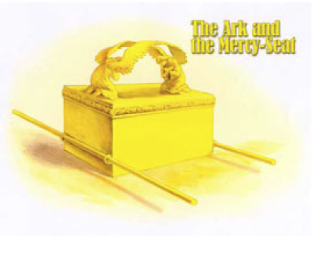
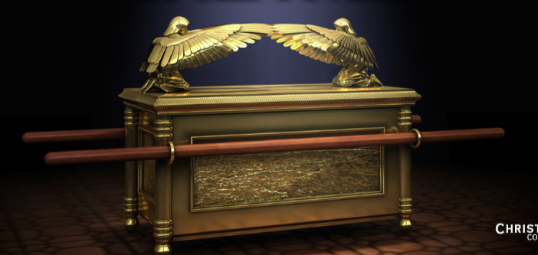
Most Holy Place
The Presence of God - Worship – In his presence
10

Slide 11
Tabernacle of Moses
1

